Slide 1
L.O: To ask questions I need answered about puberty and my body.
We will be thinking about:
Parts of puberty you are unsure or curious about.
Asking questions to find out more.

Slide 2
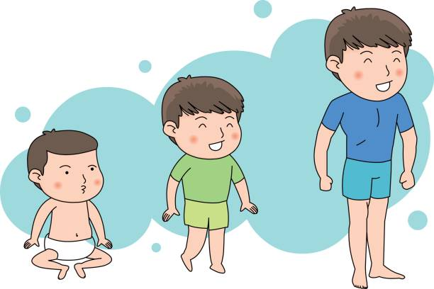
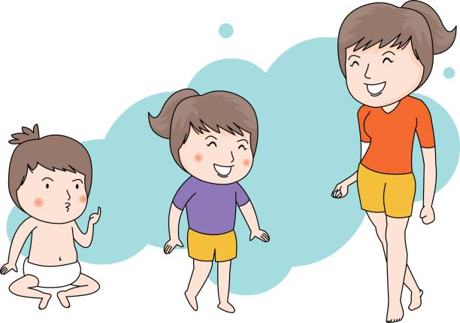
Growing and changing
What’s our starting point?
Think back over the last three lessons.
Write down three things about puberty you didn’t know but are now glad you have found out about.
This is just for you, so keep it to yourself. We don’t need to share these ideas.

Slide 3
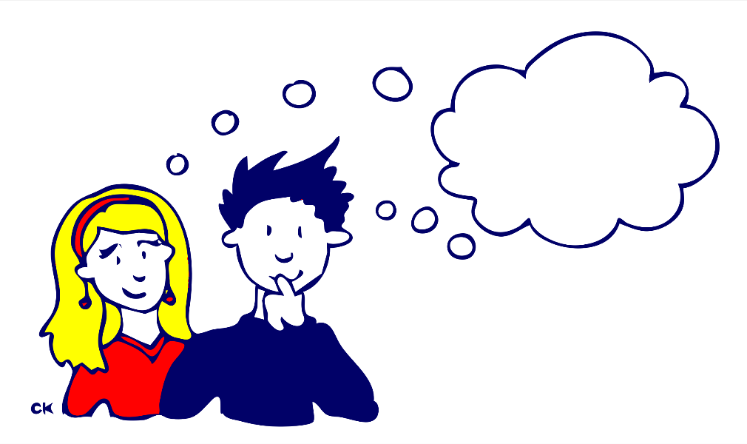
Your thoughts…
There has been a lot of information for you to take in over the last 3 lessons.
You might be wanting to know more about some things or have some questions you’d like to ask.
Anonymous Questions
If there is anything you would like to ask, write your question down on a piece of paper.
Write your name at the bottom, then just simply fold it in half and hand it in.
We will share questions anonymously – we will not say who the question was written by.

Slide 4
Your thoughts…
As your teacher, I will do my best to answer your questions.
Listen carefully to all of the questions and answers as someone may have asked something that is helpful to you.

Slide 5
Remember!
If you feel worried about puberty or what you have learned during this session, talking to an adult you trust is one of the best ways to find help.
If you want to talk to someone other than a parent:
ChildLine can help. See:
https://www.childline.org.uk/get-support/ or phone 0800 1111
Talk to a trusted adult at home
ChildLine: www.childline.org.uk
0800 1111

Slide 6
Optional extension
Build a puberty toolkit
Create an advice sheet for other young people to help them manage their emotions and physical wellbeing through puberty.
You might want to consider:
How to manage physical changes to the body.
How to manage emotional changes.
Where to get help and support.

